Slide 1
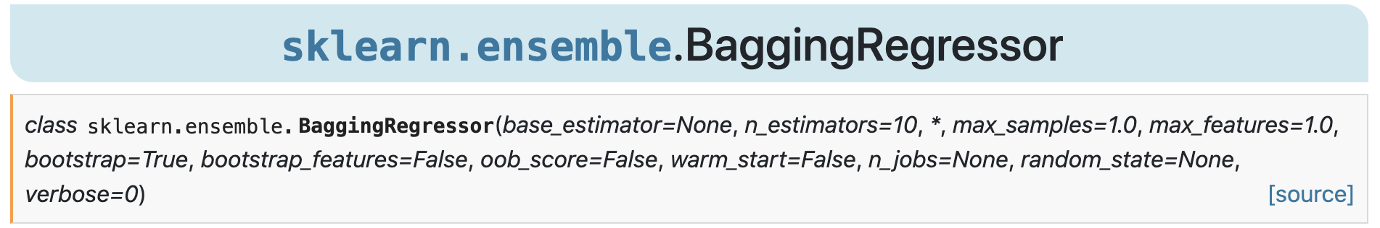
데이터셋을 복원추출해서 여러개의 sub데이터셋으로 나누고 각기다른 모델에 학습시킨뒤
평균을 산출하는 방법
=> 분산 줄여서 최종 결과물 성능 향상 효과

Slide 2
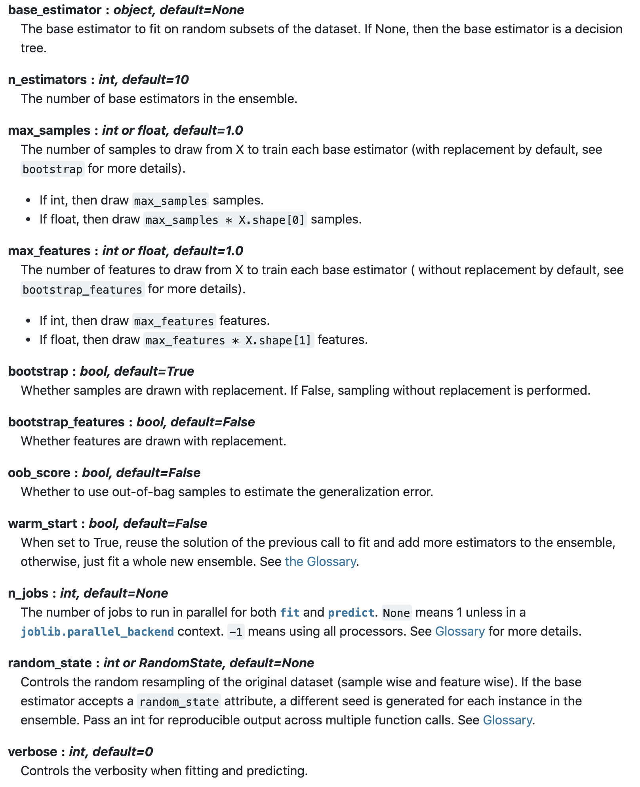

Slide 3
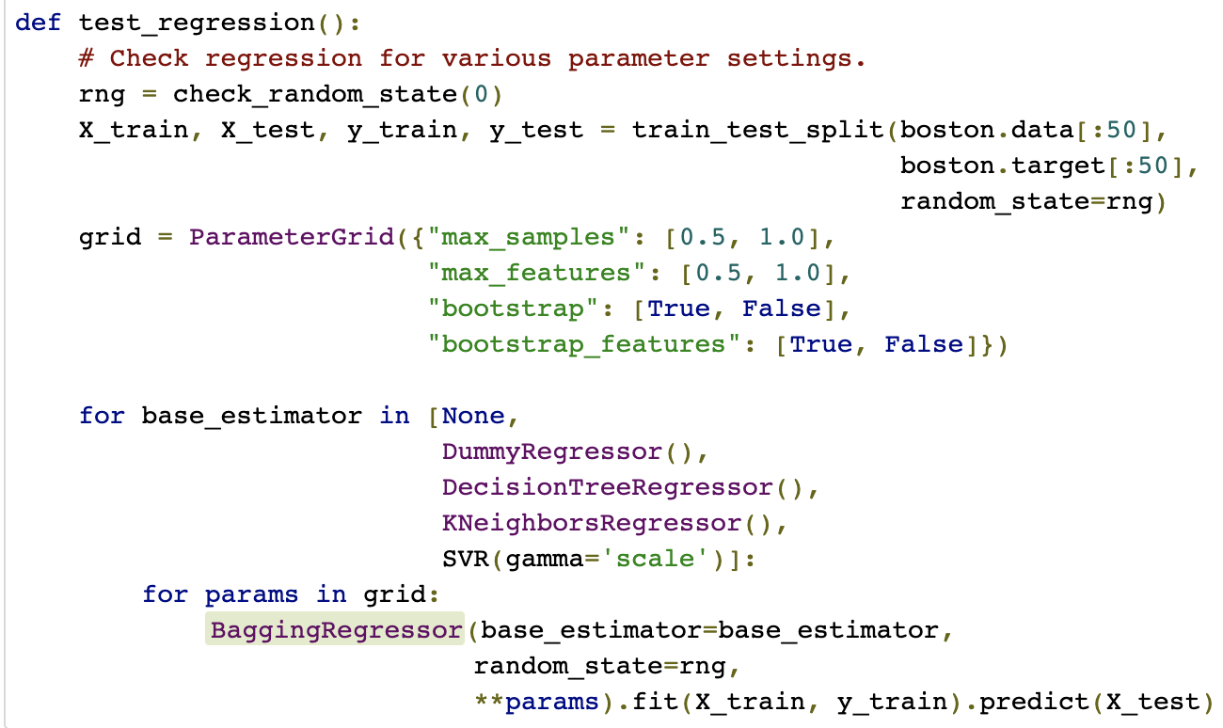

Slide 4
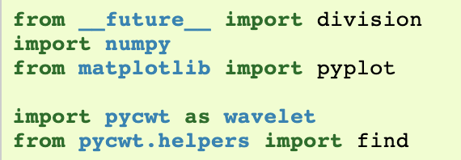
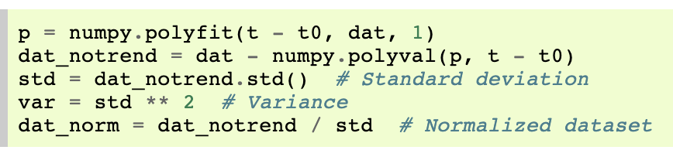
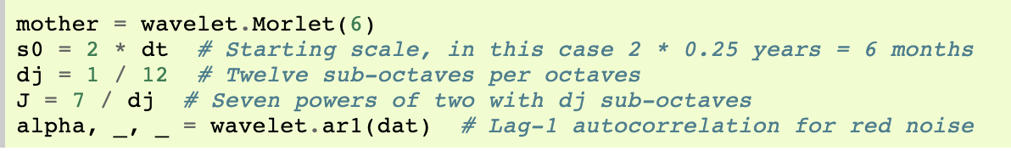
importing the relevant libraries
detrend and normalize the input data by its standard deviation
define some parameters of our wavelet analysis

Slide 5
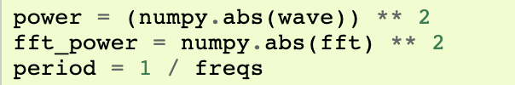
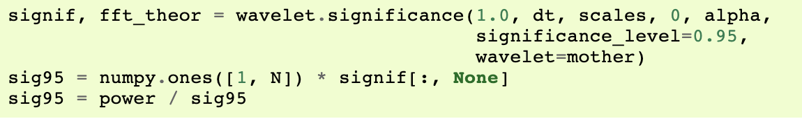
perform the wavelet transform and inverse wavelet transform using the parameters defined above.
Since we have normalized our input time-series, we multiply the inverse transform by the standard deviation.
calculate the normalized wavelet and Fourier power spectra, as well as the Fourier equivalent periods for each wavelet scale
power spectra significance test

Slide 6
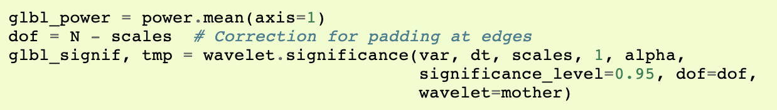
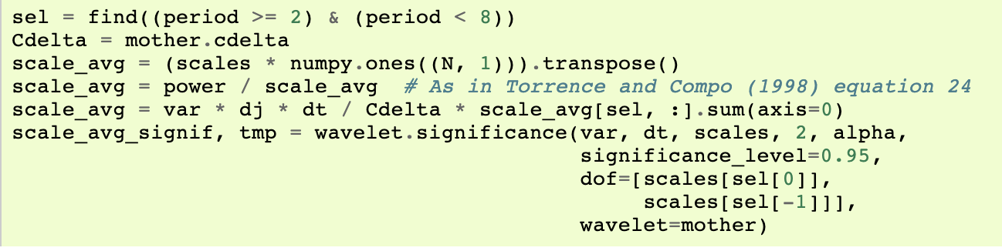
calculate the global wavelet spectrum and determine its significance level
calculate the scale average between 2 years and 8 years, and its significance level

Slide 7
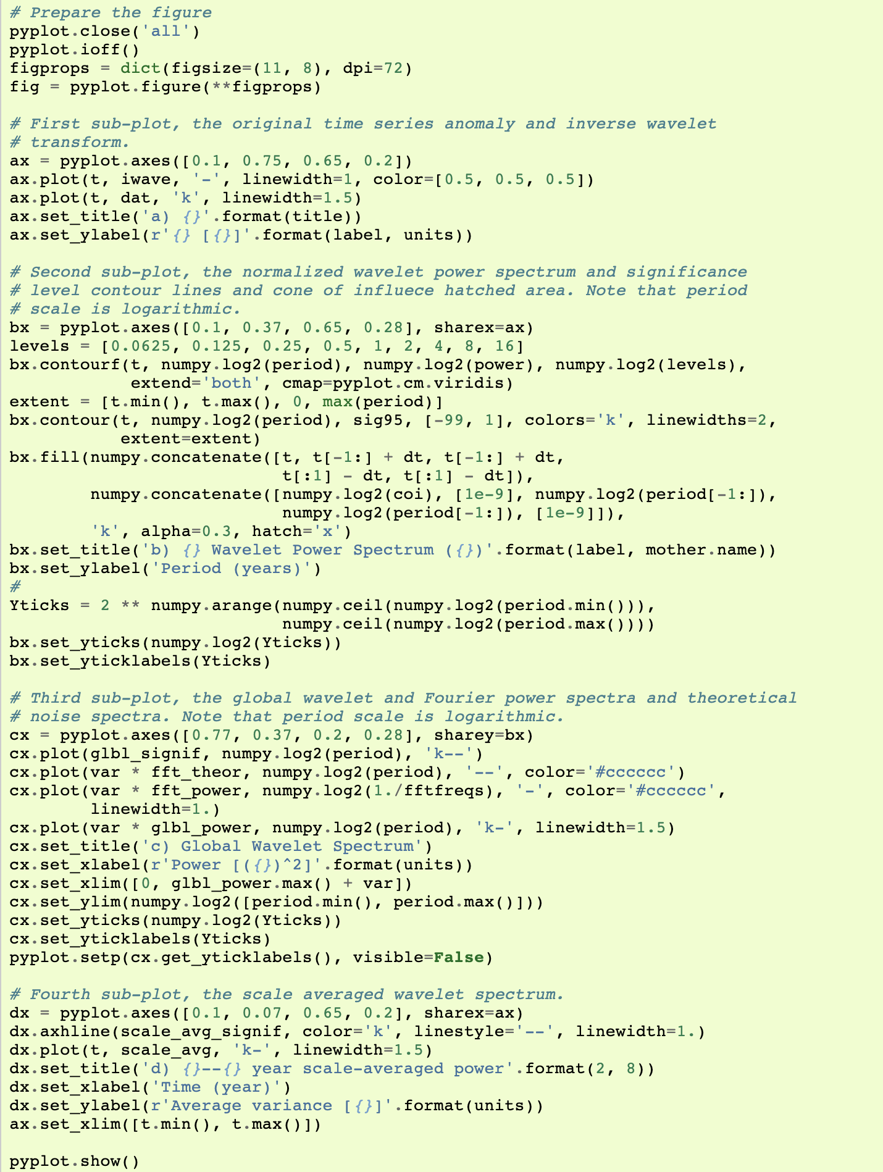
plot our results in four different subplots

